Slide 1
Google Cloud Platform

Slide 2
Bigquery
Google Cloud Storage Buckets (GCS)
Google Cloud Dataflow
Google Cloud Composer

Slide 3
BigQuery

Slide 4
BigQuery is a fully managed enterprise data warehouse
BigQuery's scalable, distributed analysis engine lets you query terabytes in seconds and petabytes in minutes.
BigQuery stores data using a columnar storage format that is optimized for analytical queries
BigQuery storage is automatically replicated across multiple locations to provide high availability.
Two Layers:
storage layer that ingests, stores, and optimizes data
compute layer that provides analytics capabilities.

Slide 5
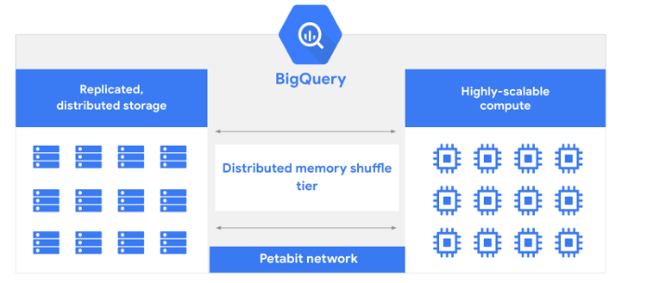

Slide 6
GCS Buckets

Slide 7
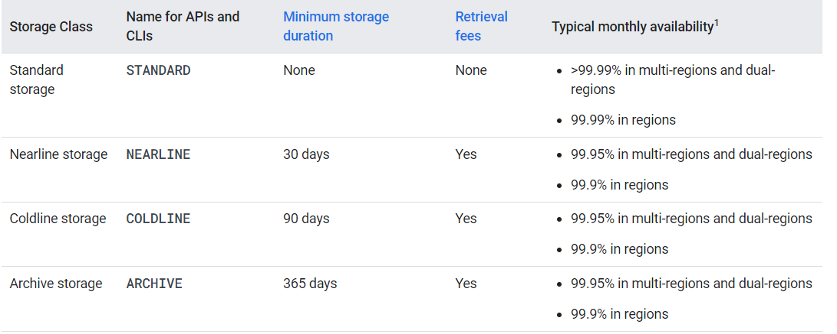
Cloud Storage is a service for storing your objects in Google Cloud.
Google Cloud Storage uses a global namespace for bucket names, so all bucket names must have unique names.

Slide 8
Usage:
log files may be stored in Cloud Storage.
Backup and archival storage, such as persistent disk snapshots, backups of on-premises systems.
data kept for audit and compliance requirements but not likely to be accessed.
As a staging area for loading data to BQ Analytics layer.
Staging are for uploading files. For example, a mobile app may allow users to upload images to a Cloud Storage bucket. When the file is created, a Cloud Function could trigger to initiate the next steps of processing.

Slide 9
Dataflow

Slide 10
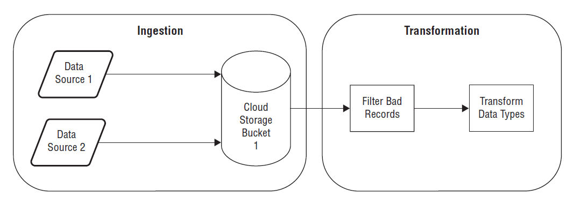
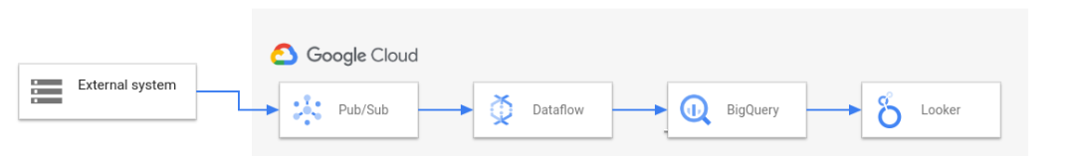

Slide 11
Dataflow is a Google Cloud service that provides unified stream and batch data processing at scale.
Use Dataflow to create data pipelines that read from one or more sources, transform the data, and write the data to a destination
Managed :
That means Google manages all of the resources needed to run Dataflow. When you run a Dataflow job, the Dataflow service allocates a pool of worker VMs to execute the pipeline.

Slide 12
Scalable
Dataflow is designed to support batch and streaming pipelines at large scale. Data is processed in parallel, so the work is distributed across multiple VMs.
Dataflow can auto scale by provisioning extra worker VMs, or by shutting down some worker VMs if fewer are needed.
Portable
Dataflow executes Apache Beam pipelines. If you decide later to run your pipeline on a different platform, such as Apache Flink or Apache Spark, you can do so without rewriting the pipeline code.

Slide 13
To run an Apache Beam pipeline using Dataflow, perform the following steps:
Use the Apache Beam SDK to define and build the pipeline. Alternatively, you can deploy a prebuilt pipeline by using a Dataflow template.
Use Dataflow to run the pipeline. Dataflow allocates a pool of VMs to run the job, deploys the code to the VMs, and orchestrates running the job.
Dataflow performs optimizations on the backend to make your pipeline run efficiently and take advantage of parallelization.
While a job is running and after it completes, use Dataflow management capabilities to monitor progress and troubleshoot.

Slide 14
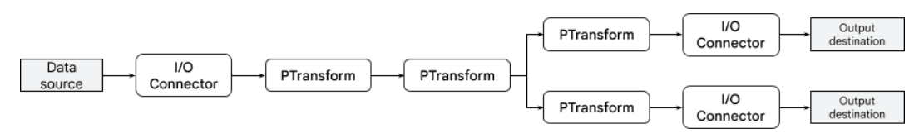
https://cloud.google.com/dataflow/docs/guides/interactive-pipeline-development
Apache Beam
The Apache Beam programming model simplifies the mechanics of large-scale data processing.
Using one of the Apache Beam SDKs, you build a program that defines the pipeline.
Then, you execute the pipeline on a specific platform such as Dataflow.
This model lets you concentrate on the logical composition of your data processing job, rather than managing the orchestration of parallel processing.

Slide 15
Basic Concepts in Apache Beam
Pipeline
Pcollection
Transforms
ParDo
Pipeline I/O
Aggregation
User Defined Functions
Runner – dataflow, spark, direct runner
Source
Sink
Text IO

Slide 16
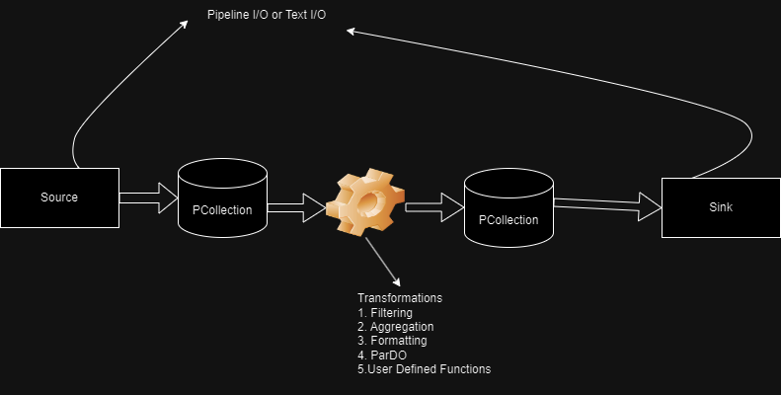
https://beam.apache.org/documentation/io/connectors/

Slide 17
Cloud Composer

Slide 18
Google Cloud Composer is a fully managed workflow orchestration service built on Apache Airflow.
It helps you author, schedule, and monitor pipelines that span across multiple tasks.

Slide 19
Scalability: Easily scale your workflows based on demand.
Monitoring: Monitor and track workflow status in real-time.
Customization: Create custom plugins and integrate with other GCP services.
Security: Built-in security features to protect your data.

Slide 20
Apache Airflow
Apache Airflow is an open-source tool for orchestrating complex computational workflows.
It allows you to define workflows as Directed Acyclic Graphs (DAGs) in Python.

Slide 21
Benefits of Airflow with Cloud Composer in GCP
Benefits of Using Airflow with Google Cloud Composer
Seamless Integration: Airflow seamlessly integrates with various GCP services.
Flexibility: Define workflows using Python and customize as needed.
Automation: Automate tasks and streamline data pipelines.

Slide 22
https://airflow.apache.org/docs/
HttpOperator
MySqlOperator
PostgresOperator
MsSqlOperator
OracleOperator
JdbcOperator
DockerOperator
HiveOperator
S3FileTransformOperator
PrestoToMySqlOperator
SlackAPIOperator

Slide 23
https://airflow.apache.org/docs/apache-airflow-providers-google/stable/operators/cloud/index.html

